Slide 1
Community Development Block Grant Program (CDBG)
Planning and economic Development Department
Pre-Development Meeting
April 13, 2022

Slide 2
CDBG Program
Overview
The U.S. Department of Housing and Urban Development (HUD) provides eligible metropolitan cities and urban counties (called "entitlement communities") with annual direct grant called the Community Development Block Grant (CDBG)

Slide 3
CDBG Program
Overview
City of Pembroke Pines is an entitlement city and is required to develop an Annual Action Plan.
Action Plan serves as an application for the CDBG funding.
City expected to receive approximately $1,017,132 in CDBG funds for Fiscal Year 2022.

Slide 4
CDBG Program
National Objectives
CDBG activities must result in one of the following:
Benefit low/mod income persons
Prevent or eliminate slums and blight
Meet an urgent need

Slide 5
Low to Moderate Income Areas

Slide 6
CDBG Program
Income Limits
April 1, 2021 (updated annually)
Household Size | Very Low Income 30% AMI and Lower | Low Income 31% to 50% AMI | Moderate Income 51% to 80% AMI
1 | $18,500 | $30,800 | $49,300
2 | $21,150 | $35,200 | $56,350
3 | $23,800 | $39,600 | $63,400
4 | $26,500 | $44,000 | $70,400
5 | $31,040 | $47,550 | $76,050
6 | $35,580 | $51,050 | $81,700
7 | $40,120 | $54,600 | $87,300
8 | $44,660 | $58,100 | $92,950

Slide 7
CDBG Program
Eligible Activities
Revitalize neighborhoods
Provide decent and affordable housing
Expand economic opportunities
Improve community facilities and services
Infrastructure Improvements
Neighborhood Facilities
Micro-Enterprise Activities
Homeownership Assistance
Development Assistance
Planning and administration costs

Slide 8
CDBG Program
Ineligible Activities
Buildings utilized for the general conduct of government
General government expenses
New housing construction
Income payments
Mortgage or utility payments
Operating and maintenance expenses

Slide 9
CDBG Program
PRIOR USE OF CDBG Funding
Housing rehabilitation for owner-occupants
Economic development (commercial rehabilitation & small business job creation and retention)
Parks and recreation facilities
Street, water, sewer, and drainage improvements
Senior-oriented facilities and services

Slide 10
CDBG FY 2021 Activities
Program | Amount
Residential Rehabilitation | $305,140
Public Service (Senior Transportation | $152,569
Public Facilities & Improvements | $355,997
Program Administration | $203,426
 | $1,017,132

Slide 11
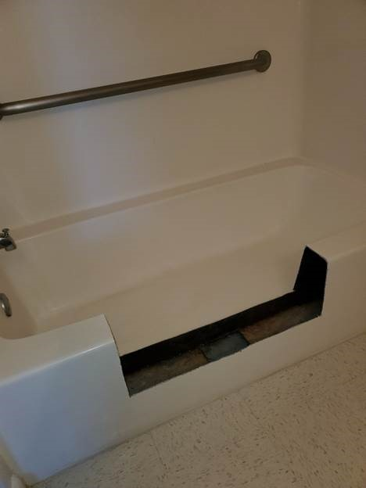
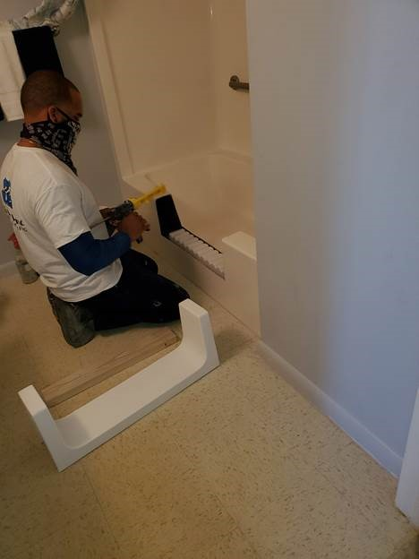
Public Facilities Senior Residence

Slide 12
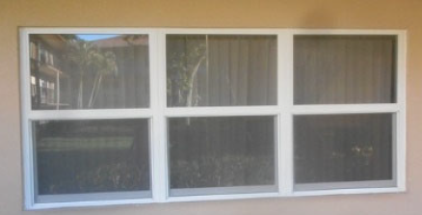
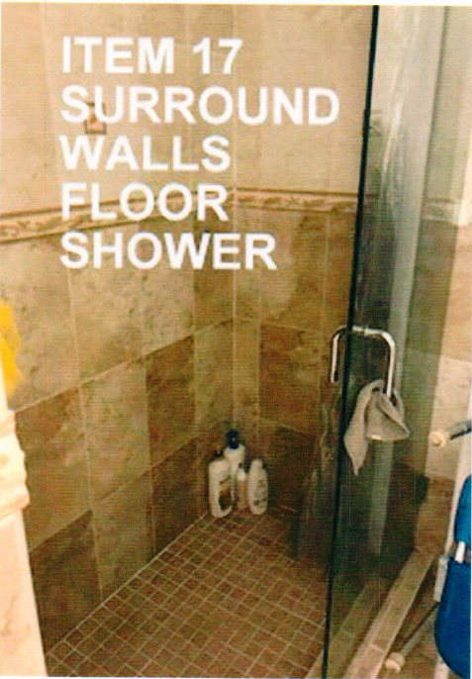
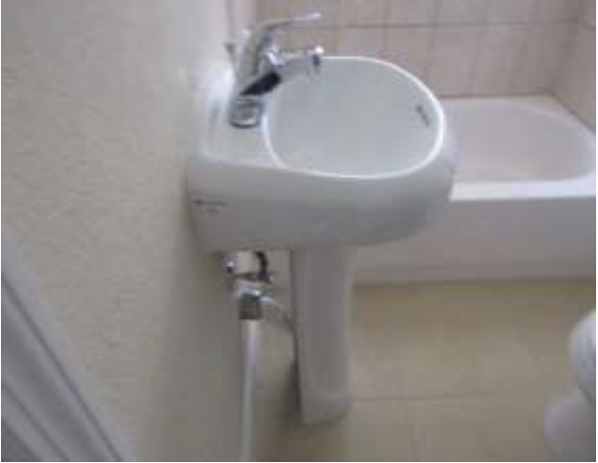
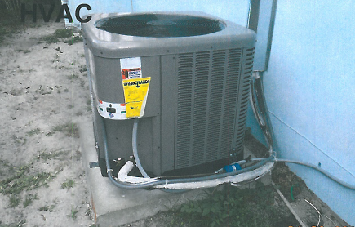
Residential Rehabilitation

Slide 13
Public Service

Slide 14
CDBG Program
CDBG-CV $1,400,676
Funding from CARES Act to be used for activities in direct response to COVID-19 pandemic.
Micro-Enterprise
Mortgage Assistance
Rental Assistance
Utilities Assistance

Slide 15
CDBG Program
Community Input

Slide 16
CDBG Program
Next Step
Develop Action Plan
Public Hearing and Presentation of Proposed Action Plan - June 15, 2022
Action Plan to HUD – August 15, 2022
Program Year Begins - October 1, 2022

Slide 17
CDBG Program
Thank You for Participating

